Slide 1

Data Structures and Analysis (COMP 410)
David Stotts
Computer Science Department
UNC Chapel Hill

Slide 2
AVL Tree
Balanced BST

Slide 3
AVL: BST with Balance
BST gets more linear as it is used (deletes) and if the build has a poor element sequence (partially sorted)
BST ops are only efficient ( O( log N) ) if the tree is close to minimal height ( log N where N is #nodes )
AVL tree (Adelson-Velskii and Landis) is a BST with a balance condition that maintains low height, bushy structure as we add and delete nodes

Slide 4
Example
insert ( 25 )
insert ( 9 )
insert ( 31 )
10
10
5
15
5
15
2
7
12
20
2
7
12
20
9
25
31

Slide 5
Example
delete( 5 )
10
10
7
15
5
15
2
9
12
20
2
7
12
20
25
9
25
31
31

Slide 6
Example
insert ( 22 )
insert ( 1 )
insert ( 45 )
insert ( 27 )
10
10
7
15
7
15
2
9
12
20
2
9
12
20
1
25
25
22
31
31
27
45

Slide 7
Example
delete ( 7 )
insert ( 4 )
insert ( 8 )
insert ( 5 )
10
10
15
9
15
7
12
20
2
12
20
2
9
25
1
4
25
1
22
22
31
8
31
27
5
27
45
45

Slide 8
Balance Rule?
What conditions can we use to give balance?
Look at root… how about
require each subtree to
have same or near
same height?
weak… you can
still get bad cases
like this

Slide 9
Balance Rule?
How about add bushy-ness…
require each path from
root to have same or near
same length?
better, still weak…
still get cases like
this that will tend
away from O(log N)
ops, toward O(N)

Slide 10
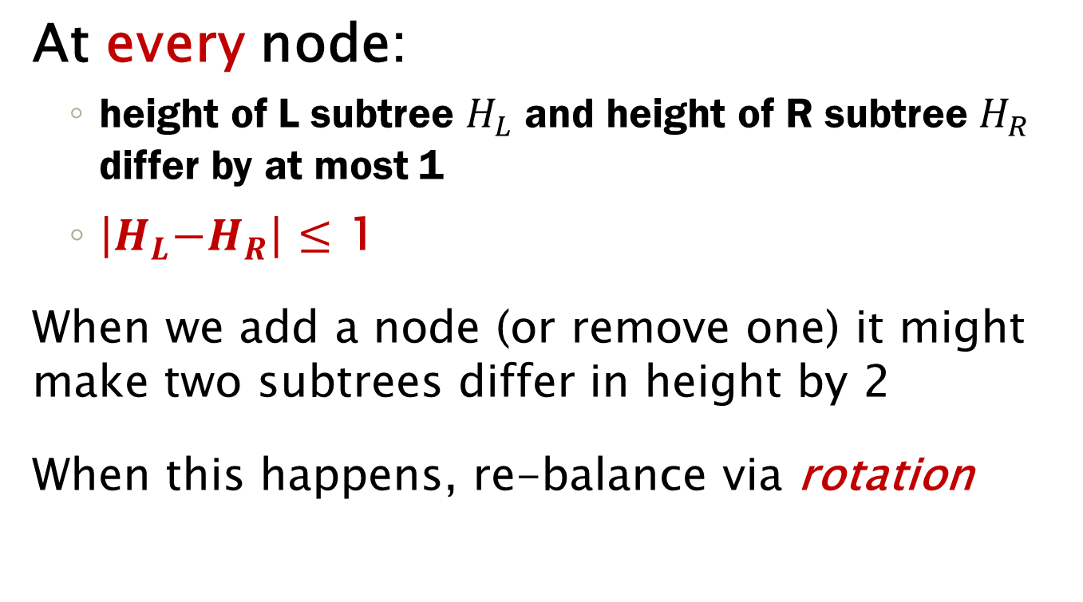
Balance Condition
At every node:
height of L subtree $H_{L}$ and height of R subtree $H_{R}$ differ by at most 1
$\left|H_{L}\right.\left.{−H}_{R}\right|$ $≤$ 1
When we add a node (or remove one) it might make two subtrees differ in height by 2
When this happens, re-balance via rotation

Slide 11
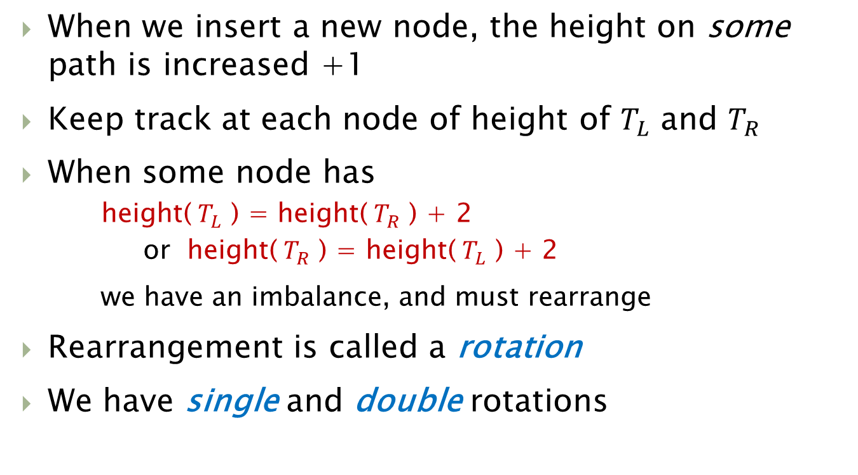
Balance Condition
When we insert a new node, the height on some path is increased +1
Keep track at each node of height of $T_{L}$ and $T_{R}$
When some node has
height(${ T}_{L}$ ) = height(${ T}_{R}$ ) + 2
or height(${ T}_{R}$ ) = height(${ T}_{L}$ ) + 2
we have an imbalance, and must rearrange
Rearrangement is called a rotation
We have single and double rotations

Slide 12

Imbalance
$$we define$$
$$height of$$
$$null as −1$$
P
-1
-1
P
1
-1
R
R
-1
0
0
-1
X
P
-1
-1
-1
-1
P
0
0
G
R
-1
-1
-1
-1

Slide 13
Basic Single Rotation
Rotation is the main balancing operation
Left and right rotations are symmetric
root becomes child
pivot ( child ) becomes root
subtree moves from pivot R to root L (or pivot L to root R )
image from Wikipedia

Slide 14




LL Single ( fig. 4.31)
Use inequalities to check BST conditions in each tree
Y parent link is moving
R
$$Y<R$$
P
$$Y>P$$
R
P
Z
X
Y
Z
Y
$$X<P$$
X
$$Z>R$$

Slide 15
LL Single Example
Insert 3, 2, 1
Imbalance at 3
1 – (-1) is 2
So rotate at 3
3
1
-1
2
0
-1
R
3
P
1
2
-1
-1
P
2
Z
R
3
1
Y
1
X
X
Y
Z

Slide 16
RR Single Example
Insert 4, 5, 6, 7
Imbalance at 3
after insert(5)
1 – (-1) is 2
So rotate at 3
this time RR
2
insert(6)
2
2
0
2
1
3
1
-1
4
1
4
1
0
1
4
-1
0
3
3
5
5
-1
0
5
-1
-1
6
-1
-1
Imbalance at 2
after insert(6)
2-0 is 2

Slide 17


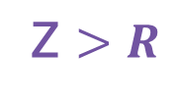
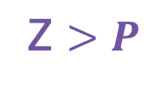
RR Example
Draw pattern chart
P
R
4
2
R
2
5
P
4
1
1
3
6
Z
X
3
5
X
Y
Y
Z
6
check BST inequalities
Y parent link is moving
$$Y<P$$
$$Y>R$$
Z $>P$
Z $>R$

Slide 18
RR Example
Now insert(7)
Imbalance at 5
1 – (-1) is 2
So rotate at 5
this time RR
4
2
5
-1
1
4
1
3
6
0
2
-1
6
7
1
3
5
7
-1
-1
Took worst case BST insert sequence, and AVL balancing makes a tree that maintains O(log N) operations

Slide 19
RL Double ( fig. 4.36)
Two rotations one R then L
R
R
A
Q
A
P
P
Q
B
D
Q
C
D
B
C
R
P
A
B
C
D

Slide 20
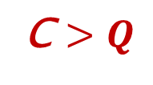
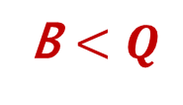

RL Double ( fig. 4.36)
Check BST inequalities
R
Q
2
R
A
P
P
1
Q
D
A
B
C
D
B
C
B – Q link moved to B – R
C – Q link moved to C - P
B $<Q$
C $>Q$
B > R
C $<P$

Slide 21
RL Double Example
Now insert 16, 15
Imbalance at 7
1 – (-1) is 2
So rotate at 7
this time RL
4
4
2
6
2
6
1
3
7
5
1
3
5
7
15
-1
1
16
16
4
0
-1
15
2
6
-1
-1
1
3
5
15
7
16

Slide 22
RL Double Example
Now insert 14
caused by insert
Into L subtree
of R child
of 6
Imbalance at 6 (and 4)
2 – (0) is 2
So rotate at 6
this time RL
4
1
3
2
6
4
0
2
5
15
R
1
3
1
2
6
0
7
16
P
-1
0
-1
-1
1
3
5
15
14
A
-1
-1
Q
7
16
Draw the pattern
D
14
B
C

Slide 23
RL Double Example
Rearrange pattern
4
4
2
R
Q
6
2
7
R
P
P
15
1
3
5
15
1
3
6
A
Q
7
16
5
16
B
14
D
A
C
D
14
B
C

Slide 24
RL Double Example
Final balance
4
1
2
the imbalance at 4 went away
by rotating at the lower imbalance
( it was at 6 )
2
7
0
0
1
1
15
1
3
6
0
0
-1
-1
-1
-1
0
-1
5
14
16
-1
-1
-1
-1
-1
-1

Slide 25
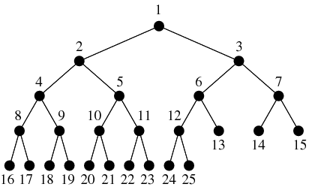
AVL path lengths
Here is a
complete binary tree
Paths root to leaf differ by at most 1

Slide 26
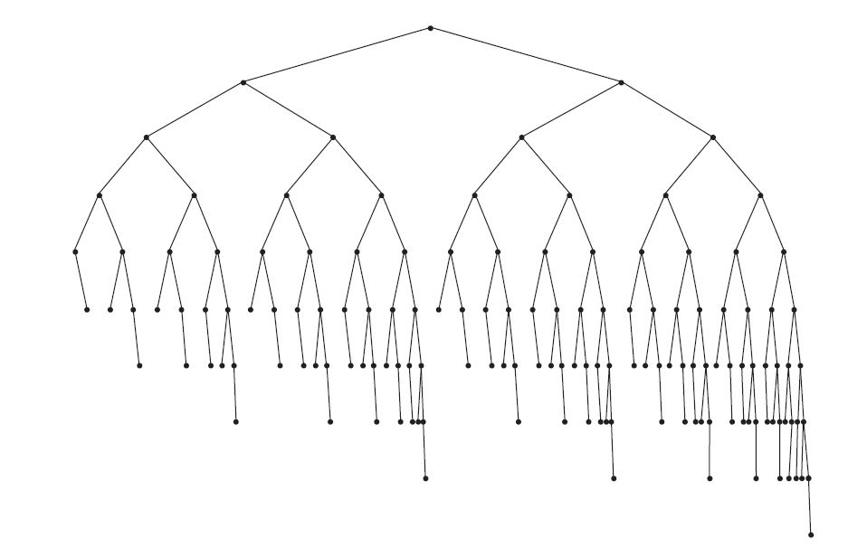
AVL Tree path lengths
AVL balance does NOT create complete binary trees
Here is a valid AVL tree
Check out the path lengths root to leaf… do any differ by more than 1?

Slide 27
AVL Tree Operations
AVL Tree visualization

Slide 28
ADT: AVL Tree AVLT
AVLT is a BST… with…
Signature
new: → BST
insert: BST x Elt → BST
remove: BST x Elt → BST
findMin: BST → Elt
findMax: BST → Elt
contains: BST x Elt → Boolean (searching)
get: BST x Elt → BST (return a cell)
val: BST → Elt (get root value)
size: BST → Nat (natural number)
empty: BST → Boolean
Diff is here… balance happens on insert and remove as needed

Slide 29
AVLT Implementation
Linked: Time complexity of operations
insert worst: O(log n), avg: O(log n)
remove worst: O(log n), avg: O(log n)
findMin worst: O(log n), avg: O(log n)
findMax worst: O(log n), avg: O(log n)
contains worst: O(log n), avg: O(log n)
get worst: O(log n), avg: O(log n)
empty O(1)
size O(1) (keep counter)
val O(1) (root access)

Slide 30
AVLT Implementation
Linked structure
Class AVLCell {
String value;
AVLCell LC;
AVLCell RC;
int LCht;
int RCht;
AVLCell parent;
}

Slide 31
END
Beyond this is just templates

Slide 32
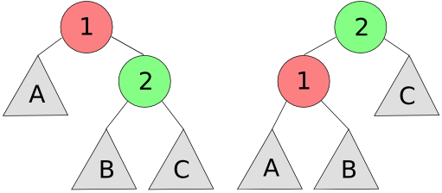
L (Left) single rotation
R single rotation is symmetric

Slide 33
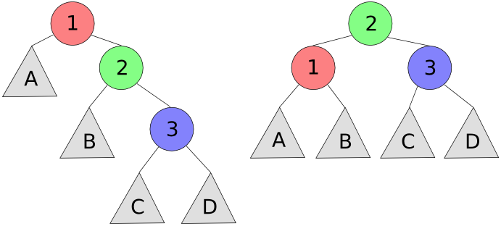
RR single rotation
LL single is symmetric

Slide 34
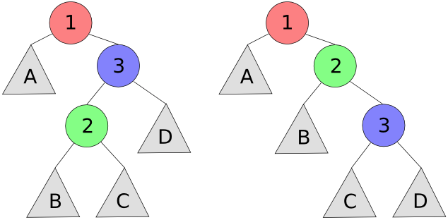
RL double rotation
LR double is symmetric

Slide 35
kappa
gamma
lambda
delta
epsilon
upsilon
alpha
beta
sigma
zeta
omicron

Slide 36
kappa
gamma
lambda
delta
epsilon
upsilon
alpha
sigma
zeta

